Slide 1

CS Bridge, Lecture 17 Final Project

Slide 2
Breakout!

Slide 3
Now’s the time for you to build something awesome.

Slide 4


Slide 5
Final Project Goals
Build something you are proud of!
Build something you are excited about building
Build something you think of yourself
Build something you can complete by the end of the class
Build something using the concepts you have learned in CS Bridge

Slide 6
Final Project Material
Think about using material we have learned so far in CS Bridge, like:
Graphics
Animation
Mouse (and Keyboard)
Control Flow + Variables
Console Programs
Lists
Image Processing
Dictionaries

Slide 7
Final Project Ideas
Brainstorm any program you want! It could be:
A game (like Breakout)
A significant extension to Breakout or another CS Bridge project
A console program that analyzes data
A graphical simulation
Interactive art
A short film
Mathematical calculations
Or anything else…

Slide 8



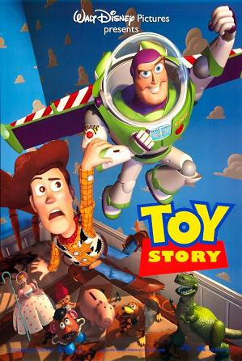
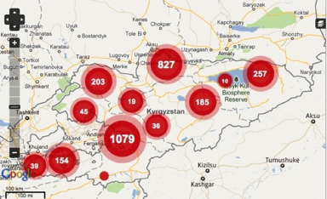
The Joy Of Building

Slide 9
Final Project Timeline
Tonight: finish Breakout / start brainstorming final project ideas
Submit Breakout by PM submission period today!
Tuesday morning: after very short lecture, meet your morning SL to discuss your final project ideas and get one approved
Rest of the week: Fun lectures + work on project
Thursday PM submission period: last chance to submit final project
Friday: Last day! Final section + showcase and party

Slide 10
Code of Conduct
https://ohlone.csbridge.org/en/resources/code-of-conduct.html
Must work on final project by yourself
No inappropriate material (e.g. violent, sexual, political)
Can not copy programs or code that are not your own
Need to indicate on submission any help you received or resources you used

Slide 11
Code of Conduct
Examples of okay things to do:
Look up documentation or examples from class
Ask SLs for help
Look at the internet for project idea inspiration
Example of things that are not okay:
Copy code from the internet
Get coding help from a friend or other person who is not CS Bridge staff

Slide 12
Python Project
Download the python project from the course website when you are ready to start coding

Slide 13
We can’t wait to see what you create!

Slide 14

Closest Thing To Magic

Slide 15
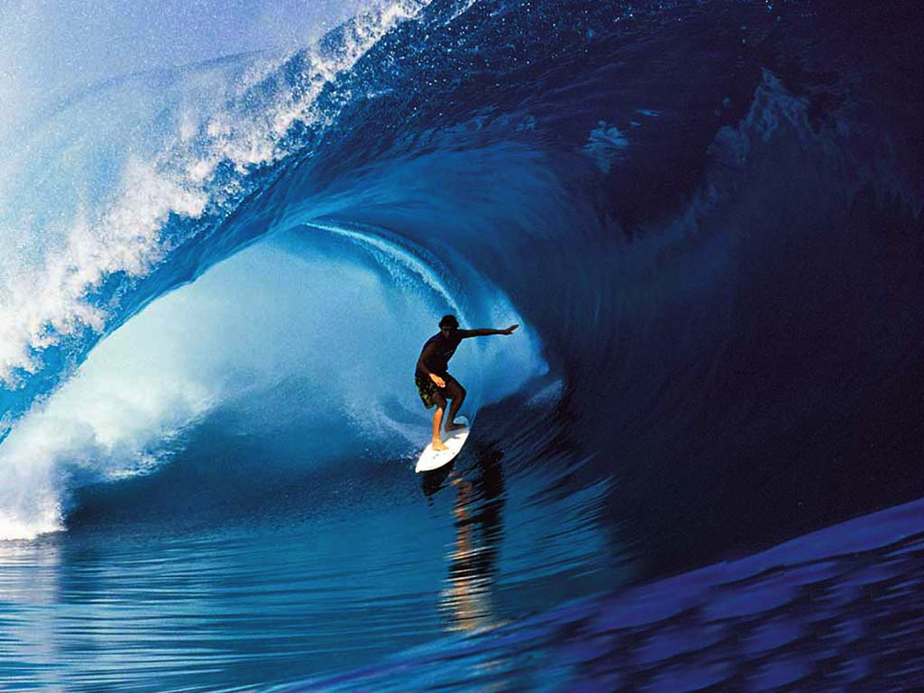
Learn By Doing

